Slide 1
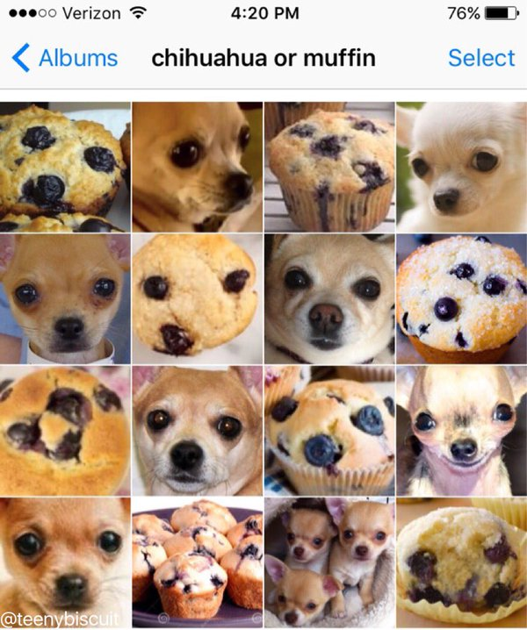

Bias- variance Tradeoff
Discover how the bias-variance tradeoff impacts the performance of machine learning models and how to achieve optimal results.

Slide 2
How does Trade-Off Bias-Variability work?
Bias
Variance
Trade-Off
Bias is the difference between the average prediction of our model and the correct value which we are trying to predict.
Variability is the ability of the model to adapt to different data sets. Greater variability implies greater complexity and risk of overfitting.
The trade-off between bias and variability seeks to find the balance to obtain an optimal model.

Slide 3
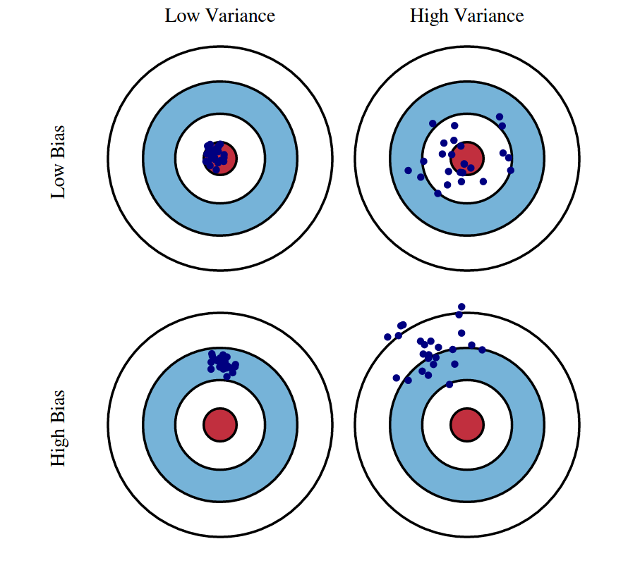
Bias- Variance

Slide 4
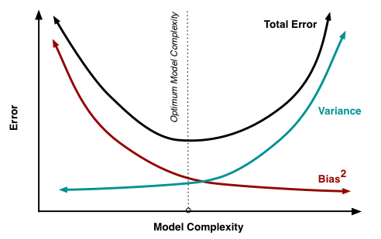
Example

Slide 5

Mathematical formulas to understand Trade-Off
1
Total Error
2
Variance Error
Total Error = Bias Error + Variance Error
Variance Error = Total Error - Bias Error
3
Bias Error
4
Minimum Error
Bias Error = Total Error – Variance Error
Minimum Error = Variance Error + Bias Error

Slide 6
Application of Trade-Off in Machine Learning
1
Machine Learning Supervised
Low variance algorithms, such as linear regression, are more suitable for small data sets and generate less risk of overfitting.
Machine Learning Not Supervised
2
High variance algorithms, such as decision trees, are most effective on large and complex data sets where adaptability is crucial.
3
In-Depth Learning
Neural networks and complex models seek to reach the optimal equilibrium through the use of regularization techniques.

Slide 7
Advantages and Disadvantages of Trade-Off Bias-Variability
Advantages
Disadvantages
Considerations
Enables more accurate and generalizable models. adjusts performance to data and problem requirements.
It requires expert knowledge to find the right balance and can be computationally expensive.
The context of the problem and the availability of data influence the choice of the appropriate trade-off.

Slide 8
How to use Trade-Off to improve model accuracy
1
Evaluate model performance
2
Modify the complexity of the model
3
Use regularization techniques
Introduce penalties to reduce variance and avoid overfitting.
Calculate the bias and variability error to identify the extent to which to fit the model.
Adjust parameters such as tree depth or number of variables to find a suitable balance.

Slide 9
Conclusions
1
Bias-variability trade-off is essential in machine learning
2
Context and data matter
3
Explore new techniques and algorithms
Carefully evaluate the problem and the data to choose the appropriate trade-off.
Research and experimentation help to discover new ways to find the optimal balance.
Understanding and managing the trade-off is key to developing accurate and generalizable models.

Slide 10

References
[1] Hastie, T., Tibshirani, R., & Friedman, J. (2009). The Elements of Statistical Learning (2nd Edition).
[2] Bishop, C. M. (2006). Pattern Recognition and Machine Learning.
[3] Vapnik, V. N. (1998). Meaningful Metrics for Learning Machines. In Advances in Neural Information Processing Systems.

